Slide 1
Pharmacy technicians working in Primary Care Networks
General Practice Alliance

Slide 2
Pharmacy technicians in different sectors
Technicians work across many different sectors, each bringing different set of challenges and require a variety of skills. Working in a GP practice is no different and will require all your skills and experience
.
.
.
.

Slide 3
Pharmacy technicians in primary care with GPA
General Practice Alliance (GPA) is our employer and is a GP Federation supporting many practice in the Northampton area http://www.northantsgpalliance.com/what-we-do/gpa-clinical-pharmacists/
This role is still fairly new and very much developing and so makes this a very exciting opportunity.
Technician work is not just dispensing medication, although hugely important, we have the skills to allow us to do so much more. Read on if your are still with us and interested…

Slide 4
Do you have some questions…click on the question to reveal the answer
What does a pharmacy technician actually do in a GP surgery?
Who will I be working with?
Where will I be working?
What training and development opportunities are there?
Click here to continue the presentation

Slide 5
What does the job involve?
Each day should bring you a great deal of variety:
.
Care home queries and support
Audits to identify areas of action and priority
Medication queries from patients, community pharmacy and practice staff
Drug monitoring and blood tests
Processing of discharge letters, letters from other healthcare settings- accurate records keeping and medicine reconciliation.
Out of stock items- alternatives
Click here to return to home page
Notes:
APTUK competency framework also gives good insight https://www.aptuk.org/site/PCPT and also PCPA website has helpful information https://pcpa.org.uk/index.php

Slide 6
Who will I be working with?
Clinical Pharmacy team:
Each Primary Care Network (PCN) has at least two pharmacists in established roles for each of the PCNS. Each PCN has 4 or 5 GP surgeries
Lead Clinical Pharmacist and a Senior Pharmacy technician supporting the whole pharmacy team
GP surgeries team:
Includes GPs, and practice staff; managers, admin, Rx clerks, secretaries, nurses.
Wider teams:
Community pharmacy, secondary care, care coordinators, SPLWs
GPA team.
Click here to return to home page

Slide 7
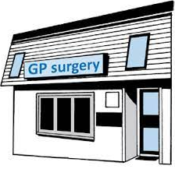
Where will I be working?
We support and offer a good mixture of working in practice and working from home.
You may work with one practice a day or perhaps split your day between practices, always within one PCN.
We support flexible & part time working as long as the core hours of the surgery are covered.
Click here for more information about our PCNs
Click here to return to home page

Slide 8
Training, support and future development
15month training pathway with CPPE
Primary Care Pharmacy Education Pathway
is part of your contract. https://www.cppe.ac.uk/career/pcpep/pcpep-training-pathway The course is attended by both pharmacists and technicians together. Consists of study days, home learning, project work and support from a education and clinical supervisor.
GPA Clinical Team: Pharmacist lead for the whole team and Pharmacy Technician line management for the Technicians.
Ongoing support from Pharmacy colleagues and the wider GPA team as well as the Practice teams.
Lots of scope to undertake projects, audits and learning.
Monthly clinical supervision and regular 1:1s providing ongoing support and learning.
Click here to return to home page

Slide 9
Further reading…
Network Contract DES www.england.nhs.uk/wp- content/uploads/2021/03/B0431-network-contract-des-specification-pcn-requirements-and-entitlements-21-22.pdf
APTUK https://www.aptuk.org/site/PCPT
PCPA https://pcpa.org.uk/pharmacy-technicians-group.html

Slide 10
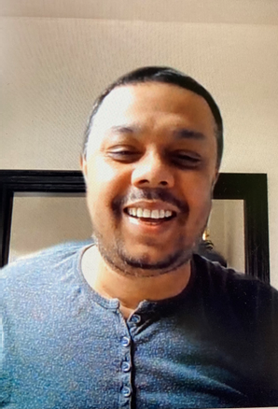
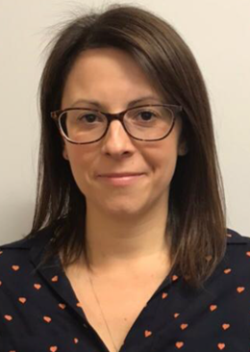
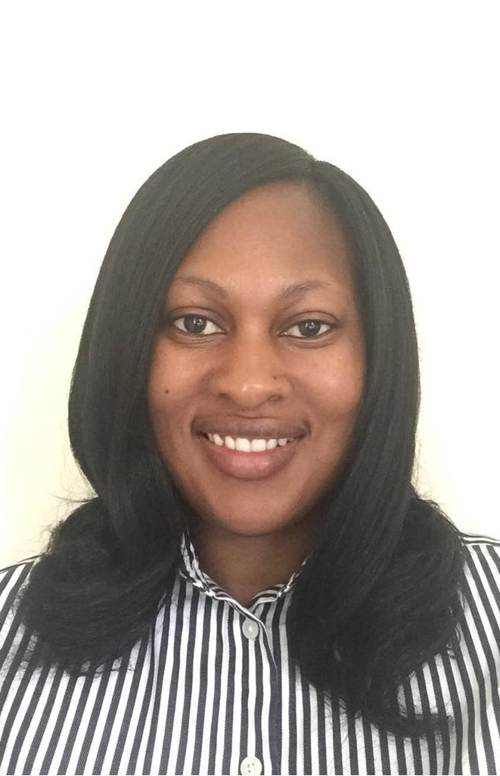
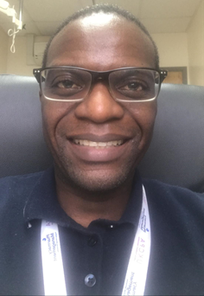
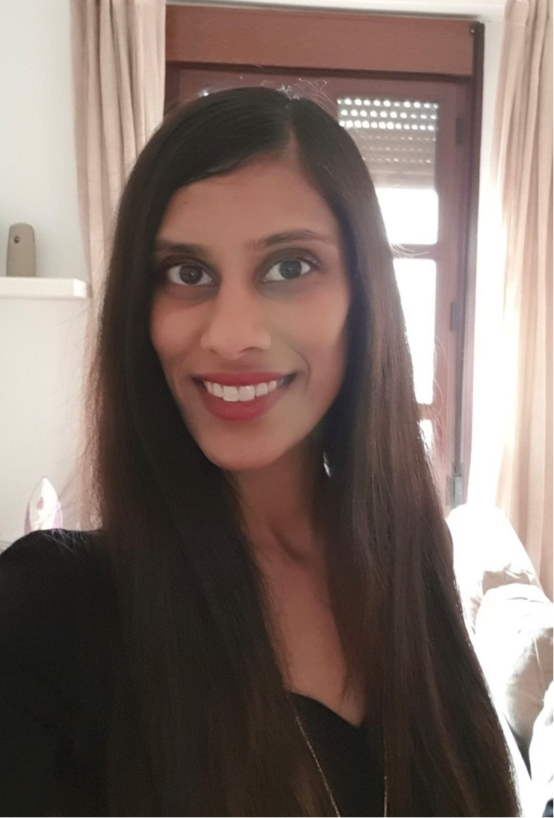
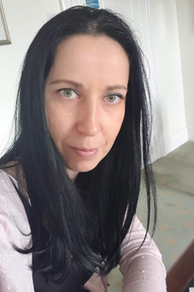
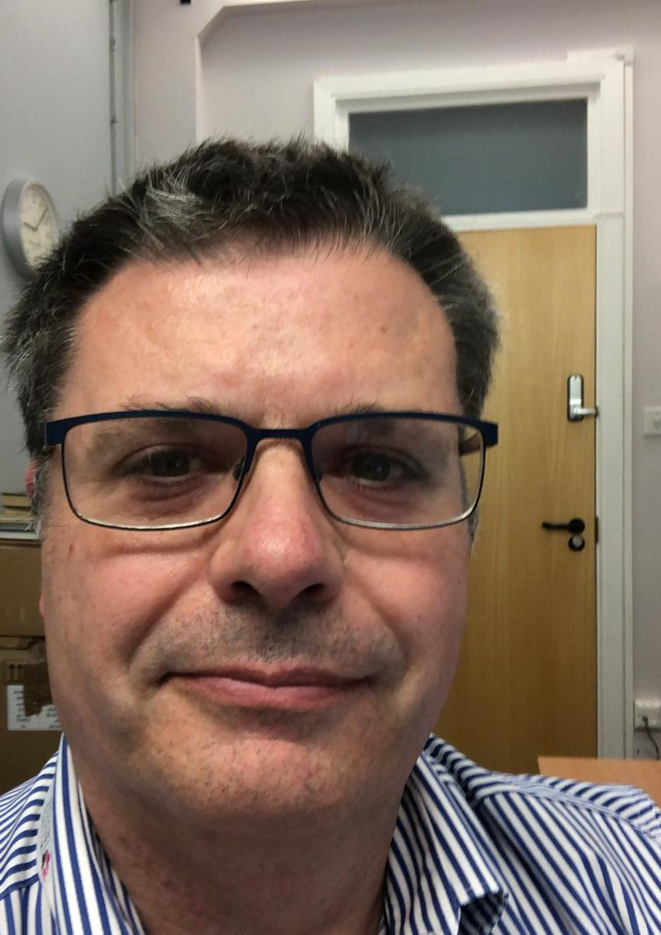
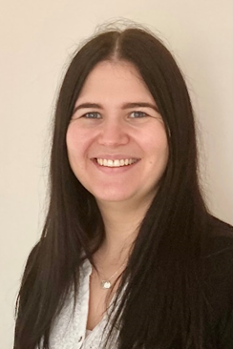
Meet the team
Clinical
Pharmacists
Pharmacy
Technicians

Slide 11
If you have any further questions, please do get in touch with:
Philippa Jones, Senior Clinical Pharmacist 07708476743 philippa.jones10@nhs.net
Zoe Webb, Senior Pharmacy Technician 07708473000 zoe.webb5@nhs.net

Slide 12
Our PCNs
Grand Union
Abington Medical Centre
Abington Park Surgery
King Edward Road Surgery
Leicester Terrace Health Centre
Greenview Surgery
Arc
Danes Camp
Rillwood
Eleanor Cross
Delapre
MMWF
Mounts
Maple Access
Weston Favell Plus
Mayfield
Click here to return to home page

